Slide 1

Object Oriented Programming Windows Tutorials Tutorial #3 : Move a Bitmap
Department of Computer Science and Information Engineering
Shuo-Han Chen (陳碩漢), shchen@csie.ntut.edu.tw
Hong-Yue Technology Research Building 1223
F 09:10 - 12:00
Notes:
Good Afternoon everyone
I am Shuo-Han Chen, a postdoctoral research fellow at Academia Sinica
It is a great honor to be invited by the department for being here today

Slide 2

Game Framework 4.10使用說明 Visual Studio 2017
練習3：移動在Game 畫面中的圖形
Notes:
Thank you for listening. Now, I would like to end today’s talk by the Q & A time.

Slide 3
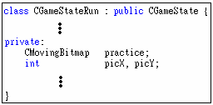
請先完成練習2A 或2B
在mygame.h 檔案中找到“CGameStateRun” class 增加成：

Slide 4
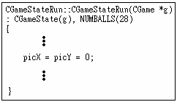
3.在mygame.cpp 檔案中，
(a) CGameStateRun:: CGameStateRun()加入：
(b) CGameStateRun::OnInit()不需修改。

Slide 5
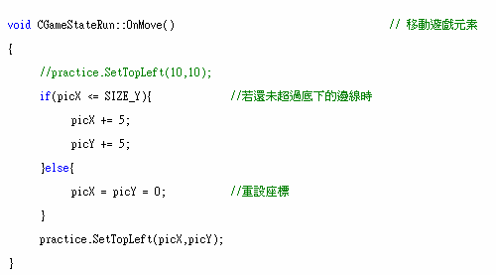
(c) CGameStateRun::OnMove()加入：(要把練習二的practice.SetTopLeft()去掉)
(d) CGameStateRun::OnShow()也不需要做任何的更改。

Slide 6
4. Compile->Run

